Slide 1
RIGOR AND REPRODUCIBILITY: BACK TO BASICS
Patricia Valdez, Ph.D.
NIH Extramural Research Integrity Officer
National Institutes of Health

Slide 2
Overview
Why the concern about reproducibility?
The NIH response
Updates to grant applications
Training and Resources

Slide 3
Overview
Why the concern about reproducibility?
The NIH response
Updates to grant applications
Training and Resources

Slide 4
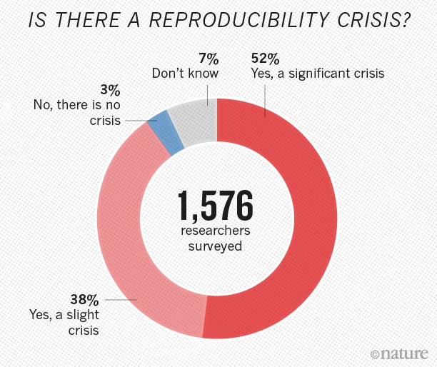
Notes:
Nature's survey of 1,576 researchers who took a brief online questionnaire on reproducibility in research.
90% of respondents thought there was a reproducibility crisis.
Over half thought it was a significant crisis.

Slide 5
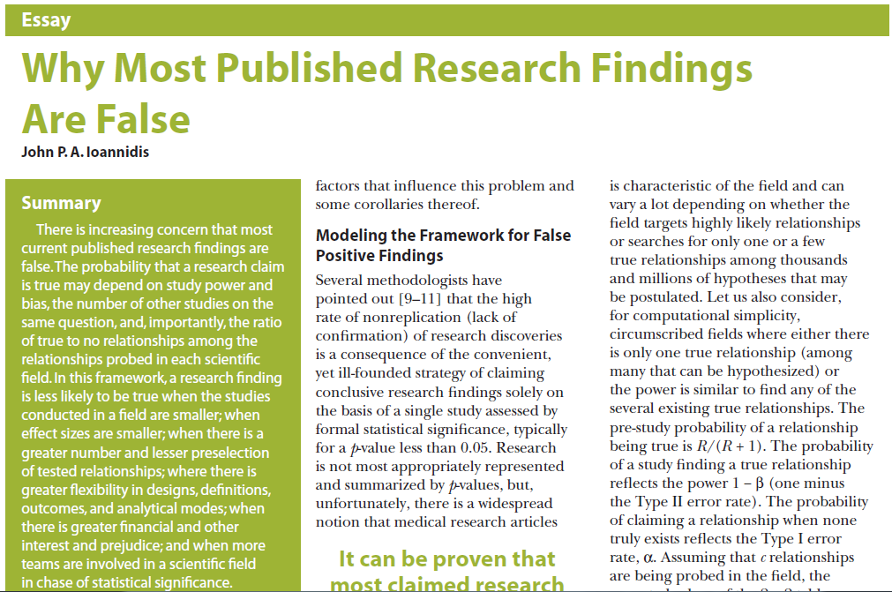
Ioannidis JP. PLoS Med. 2005 Aug;2(8):e124.
Notes:
“There is increasing concern that most current published research findings are false. The probability that a research claim is true may depend on study power and bias, the number of other studies on the same question, and, importantly, the ratio of true to no relationships among the
relationships probed in each scientific field. In this framework, a research finding is less likely to be true when the studies conducted in a field are smaller; when effect sizes are smaller; when there is a greater number and lesser preselection of tested relationships; where there is greater flexibility in designs, definitions, outcomes, and analytical modes; when there is greater financial and other interest and prejudice; and when more
teams are involved in a scientific field in chase of statistical significance.”

Slide 6
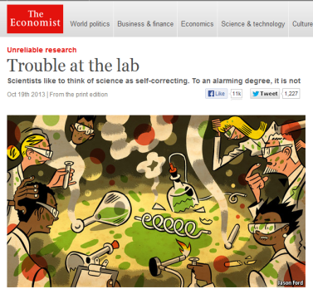
The Reproducibility Challenge
Noted by research community; in multiple publications
Across research areas
Especially in preclinical research
Notes:
Noted by research community; in multiple publications
Across research areas
Especially in preclinical research
Pharmaceutical companies unable to reproduce much of the research in the scientific literature.
Begley – Amgen
Prinz - Bayer

Slide 7
Notes:
In 2002, several studies reported that the drug minocycline increased survival of SOD1 mice, a model of ALS. NINDS funded a trial in which hundreds of ALS patients were treated with minocycline for 9 months. No benefit was found. Published in 2007.
Looking back at the preclinical studies, in many cases, blinding, randomization, sex, and transgene copy numbers were not reported.
In 2012, NINDS convened a workshop that led to publication of this perspective, calling for increased transparency in reporting.
NINDS Workshop: http://www.ninds.nih.gov/funding/areas/channels_synapses_and_circuits/rigor_and_transparency/index.htm
Landis et al article: http://www.nature.com/nature/journal/v490/n7419/full/nature11556.html

Slide 8
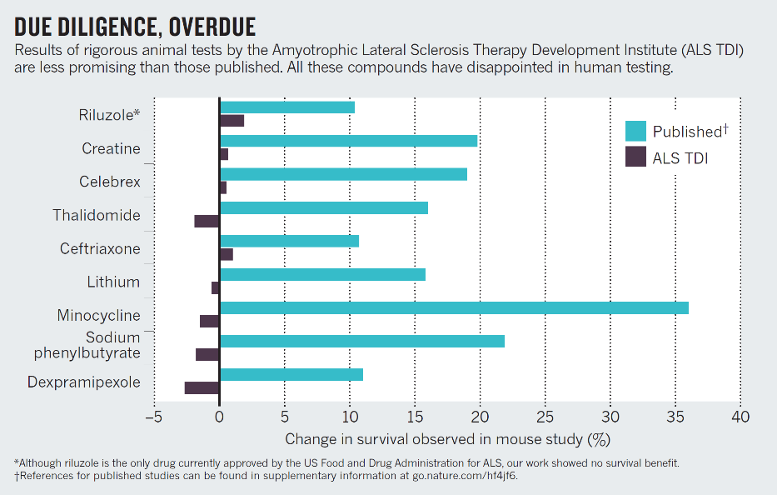
Perrin, Nature 2014; 507: 423-4255
Notes:
One year after the clinical trial data were published, ALS TDI published 5 years worth of rigorous studies exploring the effects of more than 70 drugs in a mouse model of ALS.
None showed a significant effect on the survival of mice, even those drugs previously reported to increase survival.
Small sample sizes likely led to erroneous results
http://www.nature.com/news/preclinical-research-make-mouse-studies-work-1.14913

Slide 9
Challenges to Rigor and Transparency in Reporting Science
Science often viewed as self-correcting
Immune from reproducibility problems?
Principle remains true over the long-term
In the short- and medium-term, interrelated factors can short-circuit self-correction
Leads to reproducibility problem
Loss of time, money, careers, public confidence

Slide 10
Factors That “Short Circuit” Self-correction
Poor training
Inadequate experimental design
Inappropriate use of statistics (“p-hacking”)
Incomplete reporting of resources used and/or unexpected variability in resources
Notes:
Poor training
Inadequate experimental design – fundamental quality characteristics not reported/performed (e.g. blinded assessment, randomization, sample size calculations)
Inappropriate use of statistics (“p-hacking”)
Incomplete reporting of resources used and/or unexpected variability in resources

Slide 11
Factors That “Short Circuit” Self-correction
Publication practices
Difficulty in publishing negative findings
Overemphasis on the “exciting, big picture” findings; leaves out necessary details
Current “hyper-competitive” environment
Historically low funding rates
Grant review and promotion decisions depend too much on “high profile” publications

Slide 12
Overview
Why the concern about reproducibility?
The NIH response
Updates to grant applications
Training and Resources

Slide 13
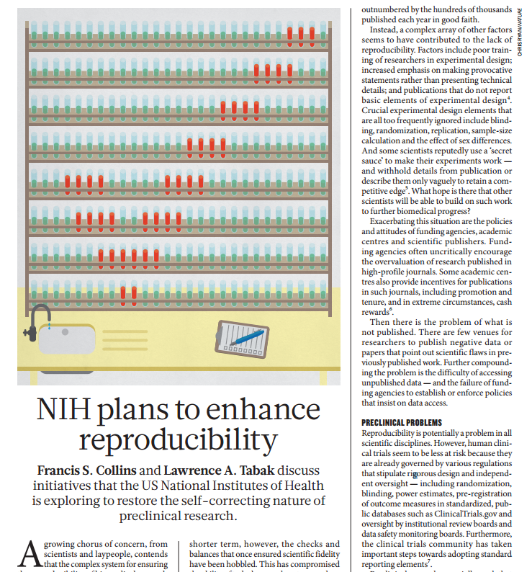
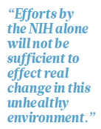

Slide 14
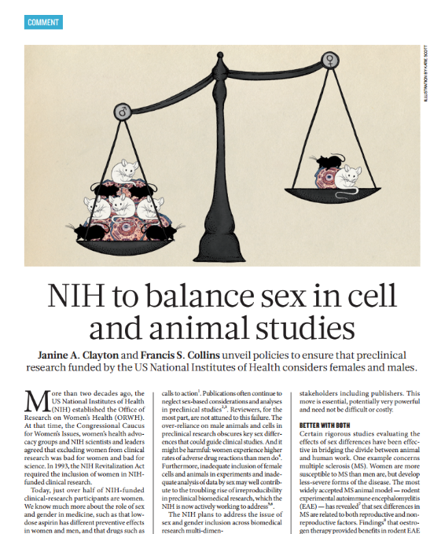
“Over the course of FY 2015, NIH plans to roll out policies that will require applicants to address inclusion of both sexes in biomedical research.”
Notes:
http://www.nature.com/news/policy-nih-to-balance-sex-in-cell-and-animal-studies-1.15195

Slide 15
Biological/Disease Impact of Experimental Design
100
Control
Treatment
80
60
Disease Impact, %
40
20
0
Aggregated
Male
Female

Slide 16
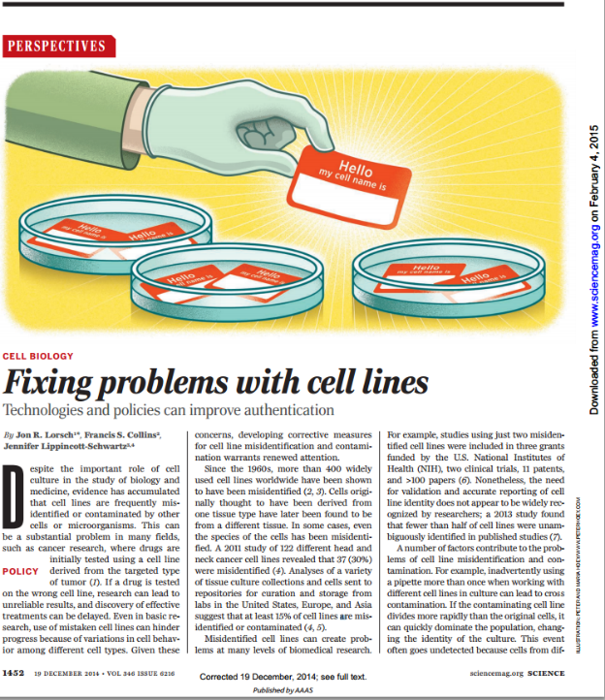
Since the 1960s, more than 400 widely used cell lines worldwide have been shown to have been misidentified
A 2011 study of 122 different head and neck cancer cell lines revealed that 37 (30%) were misidentified
Studies using just two misidentified cell lines were included in 3 grants funded by the NIH, two clinical trials, 11 patents, and >100 papers
Notes:
http://science.sciencemag.org/content/sci/346/6216/1452.full.pdf

Slide 17
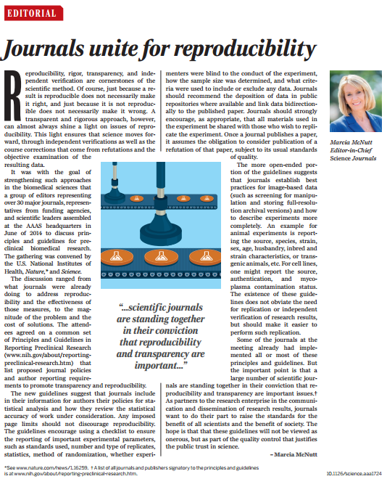
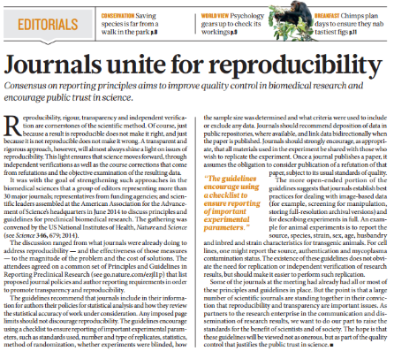
New Journal Policies to Enhance Reproducibility

Slide 18
Principles and Guidelines for Reporting Preclinical Research
Rigorous statistical analysis
Transparency in reporting
Data and material sharing
Consideration of refutations
Consider establishing best practice guidelines for:
Antibodies
Cell lines
Animals
Standards
Replicates
Statistics
Randomization
Blinding
Sample size estimation
Inclusion/exclusion criteria
http://www.nih.gov/about/reporting-preclinical-research.htm
Notes:
http://www.nih.gov/about/reporting-preclinical-research.htm

Slide 19
Our Guiding Principles for Rigor & Transparency
Clarify NIH’s long-standing expectations regarding rigor and transparency in applications
Raise awareness and begin culture shifts in the scientific community
Improve the way that applicants describe their work; provide sufficient information for reviewers
As always, ensure that NIH is investing in the best science and minimizing unnecessary burden
19

Slide 20
Enhancing Reproducibility through Rigor and Transparency
Rigor + Transparency Reproducibility
Short-term focus Long-term goal
Can measure Difficult to measure
Short-term focus to achieve long-term goal

Slide 21
26

Slide 22
Overview
Why the concern about reproducibility?
The NIH response
Updates to grant applications
Training and Resources

Slide 23
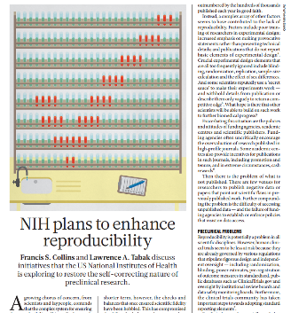
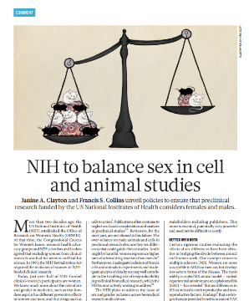
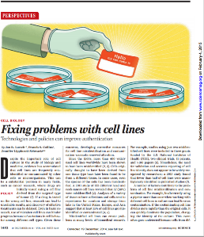
Four Areas of Clarification
Scientific premise
Scientific rigor
Relevant Biological Variables, Such as Sex
Authentication of Key Biological and/or Chemical Resources
Starting with applications due on January 25, 2016

Slide 24
Policy Applies to:
Research
Research
Career Development
Centers
People-based
Program Projects
Small Business
Resource-Related
Training (coming!)*
Individual Fellowships
Institutional Training
Institutional Career Dev
*Training in Rigor currently being piloted

Slide 25
RPG Application and Review (application due dates before Jan 25, 2019)
Element of Rigor | Section of Application | Criterion Score | Additional Review Consideration | Contribute to Overall Impact?
Scientific Premise | Research Strategy | Significance | NA | Yes
Scientific Rigor | Research Strategy | Approach | NA | Yes
Consideration of Relevant Biological Variables Such as Sex | Research Strategy | Approach | NA | Yes
Authentication of Key Biological and/or Chemical Resources | Attachment | NA | Acceptable or Unacceptable | No
Notes:
NIH policy to enhance reproducibility through rigor and transparency focuses on 4 areas:
1. Scientific Premise refers to the research used to form the basis for the proposed studies. Applicants must assess the rigor of the prior studies used to support the application, identifying any strengths or weaknesses.
2. Scientific Rigor is the strict application of the scientific method to ensure robust and unbiased experimental design, methodology, analysis, interpretation, and reporting of results. This includes full transparency in reporting experimental details so that others may reproduce and build on the findings. Applicants must provide crucial details of the experimental design, including sample size estimation, methods to reduce bias, controls, plans for statistical analyses, etc.
3. Consideration of biological variables, including age, weight and sex can affect experimental results. NIH expects that sex as a biologic variable will be accounted for in design, analysis, and reporting of research in vertebrate animals and humans. Investigators should begin to collect the data, disaggregate the data by sex and report it.
4. Authentication of key biological and/or chemical variables. Quality of resources is critical to the ability to reproduce results.

Slide 26
RPG Application and Review (application due dates on and after Jan 25, 2019)
Element of Rigor | Section of Application | Criterion Score | Additional Review Consideration | Contribute to Overall Impact?
Rigor of the Prior Research | Research Strategy | Significance | NA | Yes
Rigor of the Prior Research | Research Strategy | Approach | NA | Yes
Scientific Rigor | Research Strategy | Approach | NA | Yes
Consideration of Relevant Biological Variables Such as Sex | Research Strategy | Approach | NA | Yes
Authentication of Key Biological and/or Chemical Resources | Attachment | NA | Acceptable or Unacceptable | No

Slide 27
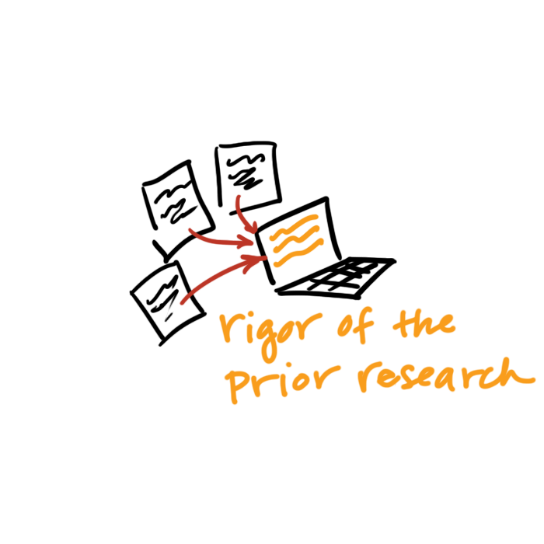
Scientific Premise / Rigor of the Prior Research
Assess the strength & weaknesses in the rigor of the prior research that serves as key support for the proposed research project.
Prior research can include:
observations,
preliminary data, or
published literature
Describe how the proposed research will address these weaknesses.
Notes:
All research builds upon prior research.
In assessing prior studies, applicants may consider:
Were experiments performed blinded?
Were experiments repeated?
Were positive and negative controls adequate?
Were statistical tests appropriate?
Were relevant biological variables considered?
Were key resources authenticated?

Slide 28
Scientific Premise (application due dates before Jan 25, 2019)
Research Strategy: Significance:
Explain the importance of the problem or critical barrier to progress in the field that the proposed project addresses.
Describe the scientific premise for the proposed project, including consideration of the strengths and weaknesses of published research or preliminary data crucial to the support of your application.
Explain how the proposed project will improve scientific knowledge, technical capability, and/or clinical practice in one or more broad fields.
Describe how the concepts, methods, technologies, treatments, services, or preventative interventions that drive this field will be changed if the proposed aims are achieved.

Slide 29
Scientific Premise (application due dates before Jan 25, 2019)
Significance – Review Questions:
Does the project address an important problem or a critical barrier to progress in the field?
Is there a strong scientific premise for the project?
If the aims of the project are achieved, how will scientific knowledge, technical capability, and/or clinical practice be improved?
How will successful completion of the aims change the concepts, methods, technologies, treatments, services, or preventative interventions that drive this field?

Slide 30
Rigor of the Prior Research (application due dates after Jan 25, 2019)
Research Strategy: Significance:
Explain the importance of the problem or critical barrier to progress in the field that the proposed project addresses.
Describe the strengths and weaknesses in the rigor of the prior research (both published and unpublished) that serves as the key support for the proposed project.
Explain how the proposed project will improve scientific knowledge, technical capability, and/or clinical practice in one or more broad fields.
Describe how the concepts, methods, technologies, treatments, services, or preventative interventions that drive this field will be changed if the proposed aims are achieved.

Slide 31
Rigor of the Prior Research (application due dates after Jan 25, 2019)
Research Strategy: Approach:
Describe the overall strategy, methodology, and analyses to be used to accomplish the specific aims of the project. Describe the experimental design and methods proposed and how they will achieve robust and unbiased results. Unless addressed separately in the Resource Sharing Plan, include how the data will be collected, analyzed, and interpreted, as well as any resource sharing plans as appropriate. Resources and tools for rigorous experimental design can be found at the NIH Enhancing Reproducibility website.
Describe plans to address weakness in the rigor of the prior research that serves as key support for the proposed project.

Slide 32
Rigor of the Prior Research (application due dates after Jan 25, 2019)
Significance – Review Questions:
Does the project address an important problem or a critical barrier to progress in the field?
Is the prior research that serves as the key support for the proposed project rigorous?
If the aims of the project are achieved, how will scientific knowledge, technical capability, and/or clinical practice be improved?
How will successful completion of the aims change the concepts, methods, technologies, treatments, services, or preventative interventions that drive this field?

Slide 33
Rigor of the Prior Research (application due dates after Jan 25, 2019)
Approach – Review Questions:
Are the overall strategy, methodology, and analyses well-reasoned and appropriate to accomplish the specific aims of the project?
Have the investigators included plans to address weaknesses in the rigor of prior research that serves as the key support for the proposed project?
Have the investigators presented strategies to ensure a robust and unbiased approach, as appropriate for the work proposed?
Are potential problems, alternative strategies, and benchmarks for success presented?
If the project is in the early stages of development, will the strategy establish feasibility and will particularly risky aspects be managed?

Slide 34
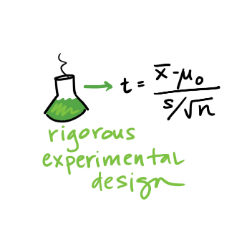
Scientific Rigor
The strict application of the scientific method to ensure robust and unbiased experimental design, methodology, analysis, interpretation and reporting of results.
Notes:
This includes full transparency in reporting experimental details so that others may reproduce and extend the findings.

Slide 35
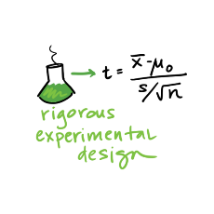
Scientific Rigor
Research Strategy: Approach:
Describe the overall strategy, methodology, and analyses to be used to accomplish the specific aims of the project. Unless addressed separately in the Resource Sharing Plan, include how the data will be collected, analyzed, and interpreted, as well as any resource sharing plans as appropriate.
Describe the experimental design and methods proposed and how they will achieve robust and unbiased results.

Slide 36
Scientific Rigor
Approach – Review Questions:
Are the overall strategy, methodology, and analyses well-reasoned and appropriate to accomplish the specific aims of the project?
Have the investigators presented strategies to ensure a robust and unbiased approach, as appropriate for the work proposed?
Are potential problems, alternative strategies, and benchmarks for success presented?
If the project is in the early stages of development, will the strategy establish feasibility and will particularly risky aspects be managed?

Slide 37
FAQ: How Much Detail Should I Include to Address Scientific Rigor?
Succinctly state what is planned
Include information on sample size estimation, powered studies, blinding, randomization, statistical analyses…
Describe experimental animal numbers here (power); VAS no longer requires justification of animal numbers.
Be transparent about your plans for analysis
Stay within page limits

Slide 38
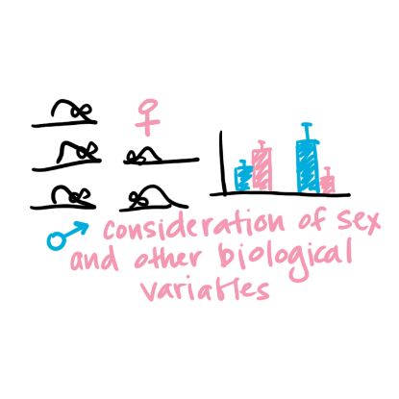
Relevant Biological Variables Such as Sex
Affect health or disease
sex,
age,
weight, and
underlying health conditions
Should be factored into research designs, analyses, and reporting in vertebrate animal and human studies.
Proposing to study one sex?
Need strong justification from the scientific literature, preliminary data, or other relevant considerations
Notes:
Biological variables, such as sex, age, weight, and underlying health conditions, are often critical factors affecting health or disease.
NIH expects that sex as a biological variable will be factored into research designs, analyses, and reporting in vertebrate animal and human studies.
Strong justification from the scientific literature, preliminary data or other relevant considerations must be provided for applications proposing to study only one sex.

Slide 39
Relevant Biological Variables Such as Sex
Research Strategy: Approach:
Explain how relevant biological variables, such as sex, are factored into research designs and analyses for studies in vertebrate animals and humans. For example, strong justification from the scientific literature, preliminary data, or other relevant considerations, must be provided for applications proposing to study only one sex. Refer to the NIH Guide Notice on Sex as a Biological Variable in NIH-funded Research for additional information.

Slide 40
Relevant Biological Variables Such as Sex
Approach – Review Questions
Have the investigators presented adequate plans to address relevant biological variables, such as sex, for studies in vertebrate animals or human subjects?

Slide 41
FAQ: Will I Have to Double My Animal Numbers?
May not need to power initial study to detect sex differences
Begin to collect data on sex for early stage research.
Justification should be provided if the application proposes to study one sex
sex-specific condition of phenomenon (e.g., ovarian or prostate cancer),
acutely scarce resources, or
sex-specific hypotheses possible due to known differences between males and females.
Cost and absence of known sex differences are inadequate justifications for not addressing sex.

Slide 42
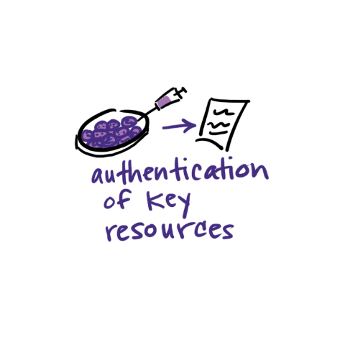
Authentication of Key Biological and/or Chemical Resources
Quality of established resources is critical
Cell lines, Antibodies, Chemicals, Mice, etc.
Provide a plan to regularly authenticate to ensure identity & validity
Each investigator determines which resources are key
Notes:
Each investigator will have to determine which resources used in their research fit these criteria and are therefore key to the proposed research.

Slide 43
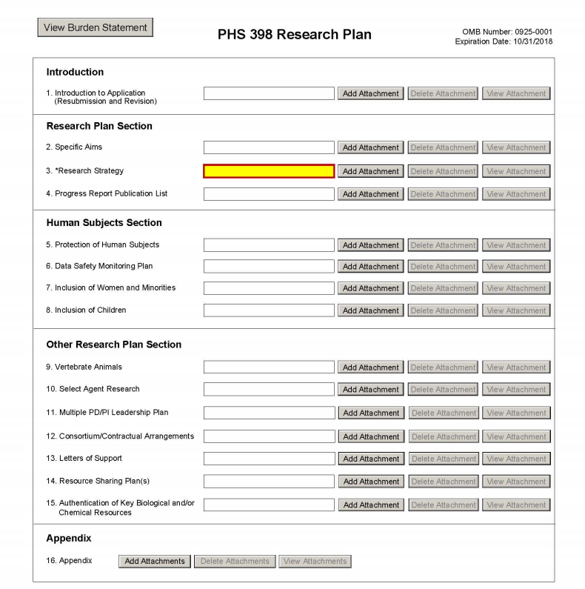
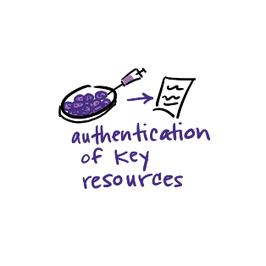
Authentication Plan Attachment
Notes:
Plans for Authentication of Key Biological and/or Chemical Resources should be described in attachment.

Slide 44
Authentication of Key Resources
Other Research Plan Section - Instructions
If applicable to the proposed science, briefly describe methods to ensure the identity and validity of key biological and/or chemical resources used in the proposed studies. No more than one page is suggested.
Key biological and/or chemical resources are characterized as follows.
Key biological and/or chemical resources may or may not be generated with NIH funds and: 1) may differ from laboratory to laboratory or over time; 2) may have qualities and/or qualifications that could influence the research data; and 3) are integral to the proposed research. These include, but are not limited to, cell lines, specialty chemicals, antibodies, and other biologics.
Standard laboratory reagents that are not expected to vary do not need to be included in the plan. Examples are buffers and other common biologicals or chemicals.
See NIH's page on Rigor and Reproducibility for more information.

Slide 45
Authentication of Key Resources
Additional Review Consideration:
For projects involving key biological and/or chemical resources, reviewers will comment on the brief plans proposed for identifying and ensuring the validity of those resources.

Slide 46
Reminder: Authentication Of Key Biological and/or Chemical Resources (NOT-OD-17-068)
Definition of key biological and/or chemical resources
Examples (cell lines, chemicals, genetically modified animals or cells)
Do not include:
Plans for authentication of data sets, databases, machinery, or electronics
Plans for the development and authentication of new key biological and/or chemical resources
Plans for authentication of standard laboratory reagents that are not expected to vary
Authentication or other data
Notes:
Key resources refer to established resources that will be used in the proposed research
If key resources have been purchased or obtained from an outside source that provided data on prior authentication, the investigator is still expected to provide their own authentication plans for these key resources.
Do not include authentication data in the Authentication of Key Biological and/or Chemical Resources attachment. Include only a description of the methods proposed to authenticate key resources.
Do not include plans for authentication of data sets, databases, machinery, or electronics in the Authentication of Key Biological and/or Chemical Resources attachment.
Do not include plans for development and authentication of new key biological and/or chemical resources (such as a human cancer cell line). Applications proposing to generate a new key biological and/or chemical resource must describe development and authentication of the resource in the Approach section.
Do not include plans for authentication of standard laboratory reagents that are not expected to vary. Examples are buffers and other common biologicals or chemicals.
We are encouraging scientific societies and the research community to develop standard approaches.
The Authentication plan is not scored, so if the application is meritorious, the applicant may work with the program officer to address any deficiencies prior to award.

Slide 47
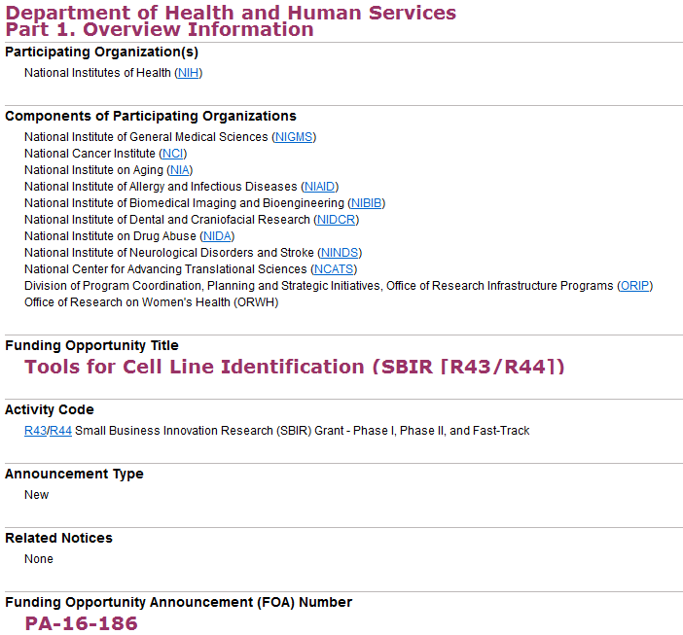
Notes:
Funding Opportunity Purpose
This Funding Opportunity Announcement (FOA) is intended to address the problem of misidentified cell lines. Many advances in biomedical science have arisen from studies of cultured cell lines, which are widely used for basic research on cell function, as models for disease, and for drug screening. However, cell cultures are prone to contamination by foreign cells, which may rapidly displace the original cells. The identity of cultured cells should be routinely verified, but a majority of laboratories do not monitor the identity of their cell lines, and many cell lines are misidentified. The costs, effort and time required to confirm the identity of cell lines has been a barrier to adoption of cell line identification as a routine quality control measure. This FOA will support SBIR projects to improve existing technologies, and/or develop novel, reliable, and cost effective tools that will make it easier for researchers to confirm the identity and/or sex of the cells that they use in their work. Applications for support of research and development of particular types of complex technologies that require funding levels and durations beyond those reflected in standard SBIR guidelines are encouraged, as are multi-PD/PI applications, including multi-PD/PI applications that arise from academic-industrial partnerships.
Expires April 6, 2019

Slide 48
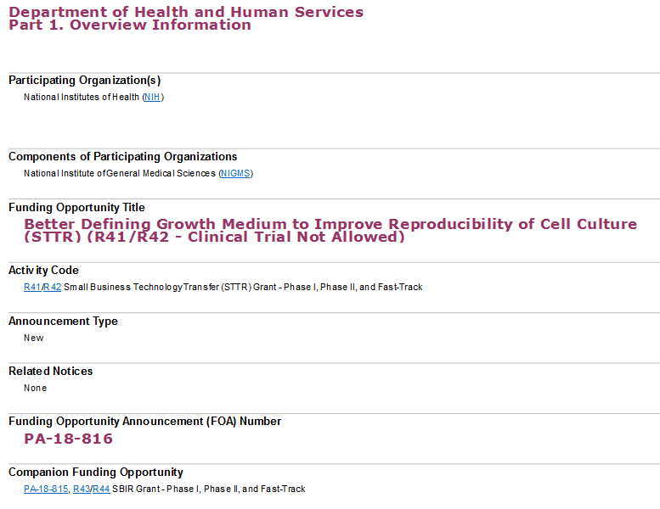
Notes:
Funding Opportunity Purpose
Fetal bovine serum (FBS) is the most widely used growth supplement for cell culture because it cost-effectively supports the survival and growth of many cell lines. Although serum is an effective growth promotor, it is highly variable in its composition, activity, and physiological effects on cells. This variability introduces inconsistencies into cell culture research. This Funding Opportunity Announcement (FOA) will support STTR projects to develop novel, reliable, and cost-effective tools that will make it easier for researchers to standardize or replace serum in cell culture.

Slide 49
Research Performance Progress Reports (RPPR)
RPPR updates for rigor and transparency:
prepare non-competing renewals for the next competitive renewal, and
help NIH implement and evaluate the policy for both current and new awards.
See NOT-OD-16-005 & NOT-OD-16-031

Slide 50
Research Performance Progress Reports (RPPR)
B.2 What was accomplished under these goals?
Goals are equivalent to specific aims. In the response, emphasize the approaches taken to ensure robust and unbiased results. Include the significance of the findings to the scientific field.
B.6 What do you plan to do for the next reporting period to accomplish the goals?
Include any important modifications to the original plans, including efforts to ensure that the approach is scientifically rigorous and results are robust and unbiased. Provide a scientific justification for any changes involving research with human subjects or vertebrate animals. A detailed description of such changes must be provided under Section F. Changes.

Slide 51
Overview
Why the concern about reproducibility?
The NIH response
Updates to grant applications
Training and Resources

Slide 52
Training
NIH will require a description of instruction in the design and conduct of rigorous experiments.
Institutional training
Institutional career development
Individual fellowships
See NOT-OD-16-034
Rigor-training required for some FOAs (PAR-17-341, PAR-18-686, PAR-17-052, PA-18-614, & RFA-MH-510)
Notes:
Training in rigor should occur throughout the training experience, on a day-to-day basis.
There is a need for training to focus on rigor and transparency to enhance reproducibility
NIH will create another section of training grants that will be reviewed as an additional review criteria, that can impact overall score
This includes institutional training as well as Fellowships
NIH will require a description of instruction in the design and conduct of rigorous experiments.
Institutional training
Institutional career development
Individual fellowships
Additional guidance on training requirements will be forthcoming, see NOT-OD-16-034
Image courtesy of NIH NIAD

Slide 53
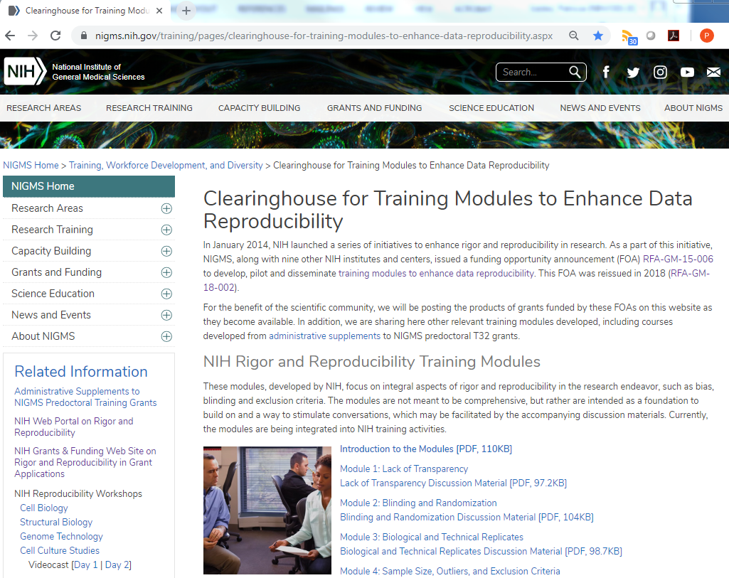
Notes:
https://www.nigms.nih.gov/training/pages/clearinghouse-for-training-modules-to-enhance-data-reproducibility.aspx

Slide 54
Notes:
https://obssr.od.nih.gov/training/

Slide 55
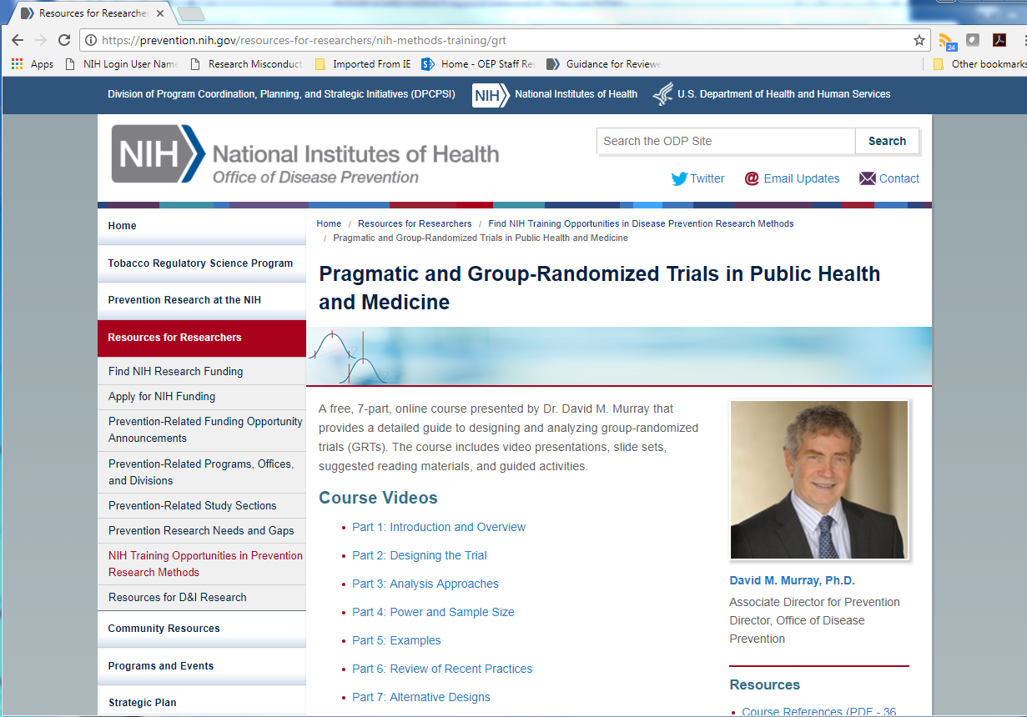
Notes:
https://prevention.nih.gov/resources-for-researchers/nih-methods-training/grt

Slide 56
Administrative Supplements for Predoctoral Training in Rigor
“Graduate schools ‘mostly teach facts the first year,’ said Jon Lorsch, director of the National Institute of General Medical Sciences at the NIH. ‘They should teach methods.’”
-Harris, Richard. (2017). Rigor Mortis: How Sloppy Science Creates Worthless Cures, Crushes Hope, and Wastes Billions. New York: Basic Books.
PA-15-136: Availability of Administrative Supplements to NIGMS Predoctoral Training Grants (Admin Supp)
PA-16-060: Availability of Administrative Supplements to NIGMS Predoctoral Training Grants (Admin Supp)
Notes:
Jon Lorsch quoted in Rigor Mortis: “A few years ago, the NIH put out a request to the nation’s graduate schools, asking for a list of the classes that teach biomedical methods. The idea was to take the best of these classes and make the curriculum more broadly available. Lorsch said the survey was a bust.”

Slide 57
Notes:
NIGMS issued FOAs in FY2015 and FY2016 to support the development and implementation of curricular activities aimed at (1) providing graduate students with a strong foundation in research design and methods in areas related to conducting reproducible and rigorous research
Details of 22 projects funded by Administrative Supplements to NIGMS Predoctoral Training Grants (Admin Supp)

Slide 58
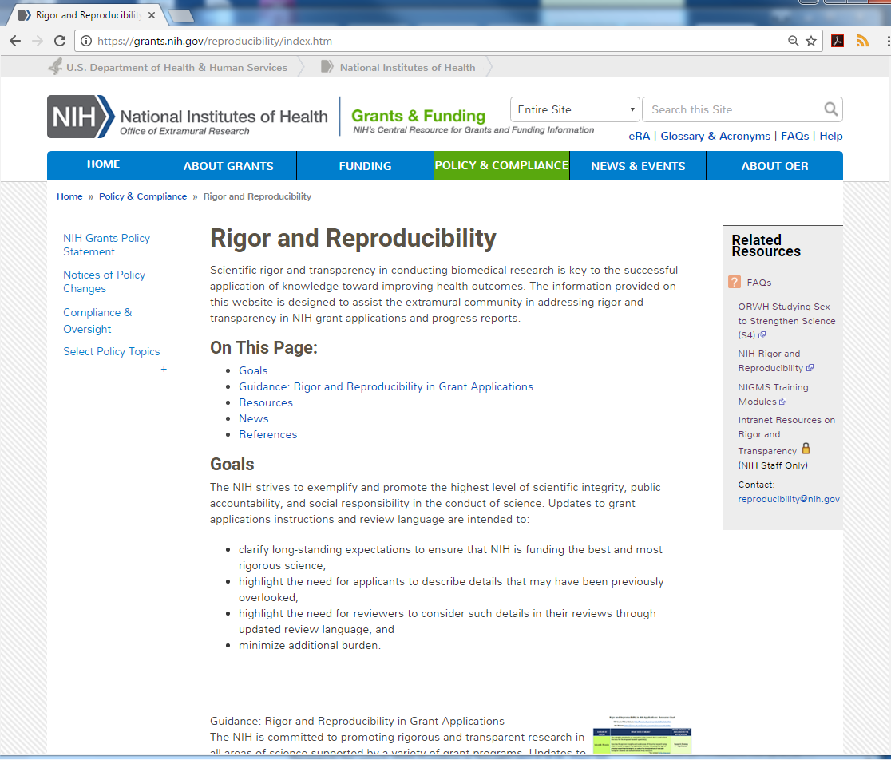
https://grants.nih.gov/reproducibility/index.htm
Updates coming November 2018:
Authentication Plan examples
Resources for experimental design
Application instructions will link here

Slide 59
NIH Policy: Enhancing Reproducibility through
Rigor and Transparency
Module 1: General Policy Overview
reproducibility@nih.gov
Notes:
Welcome! You have entered the National Institutes of Health's introductory training module for "Enhancing Reproducibility through Rigor and Transparency," a policy designed to clarify NIH's expectations for grant applications and peer review.
External: https://grants.nih.gov/reproducibility/module_1/presentation.html

Slide 60
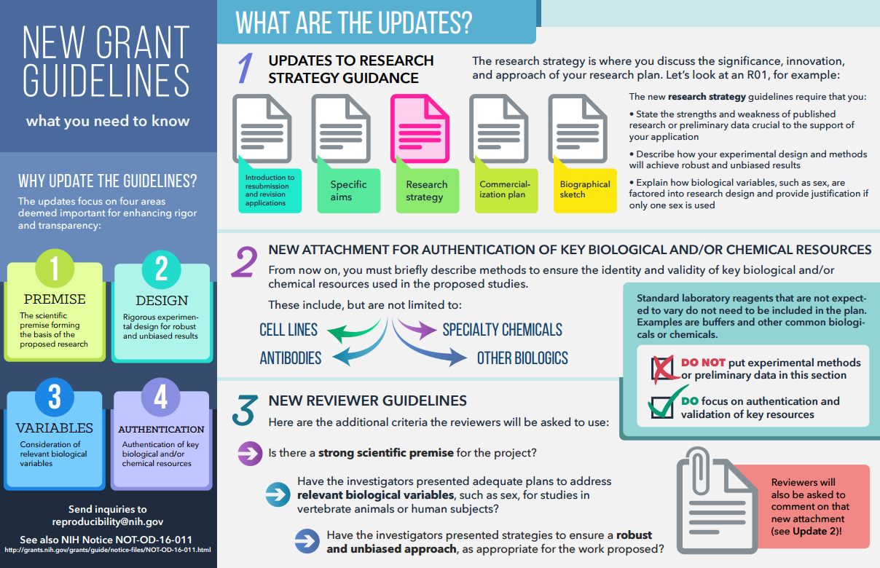

Slide 61
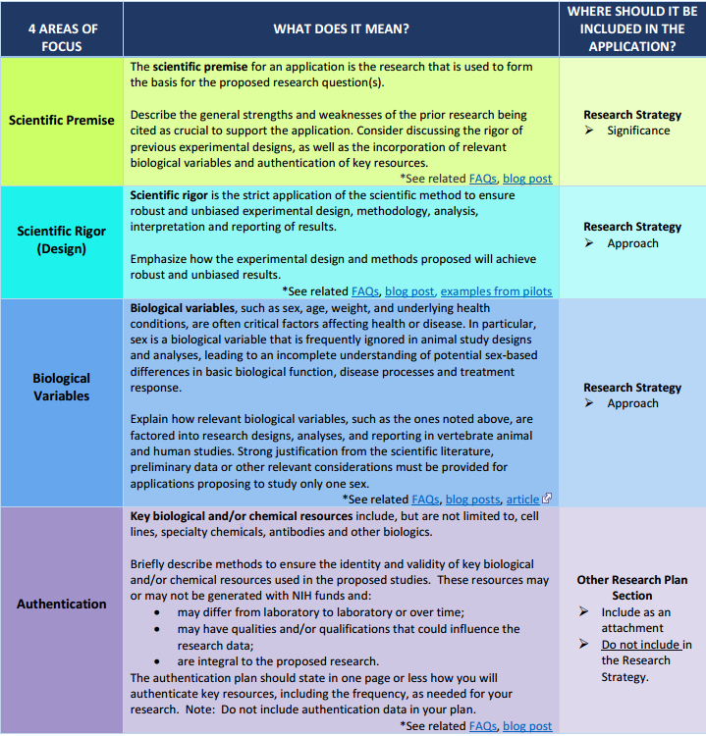
Updates coming
November 2018

Slide 62
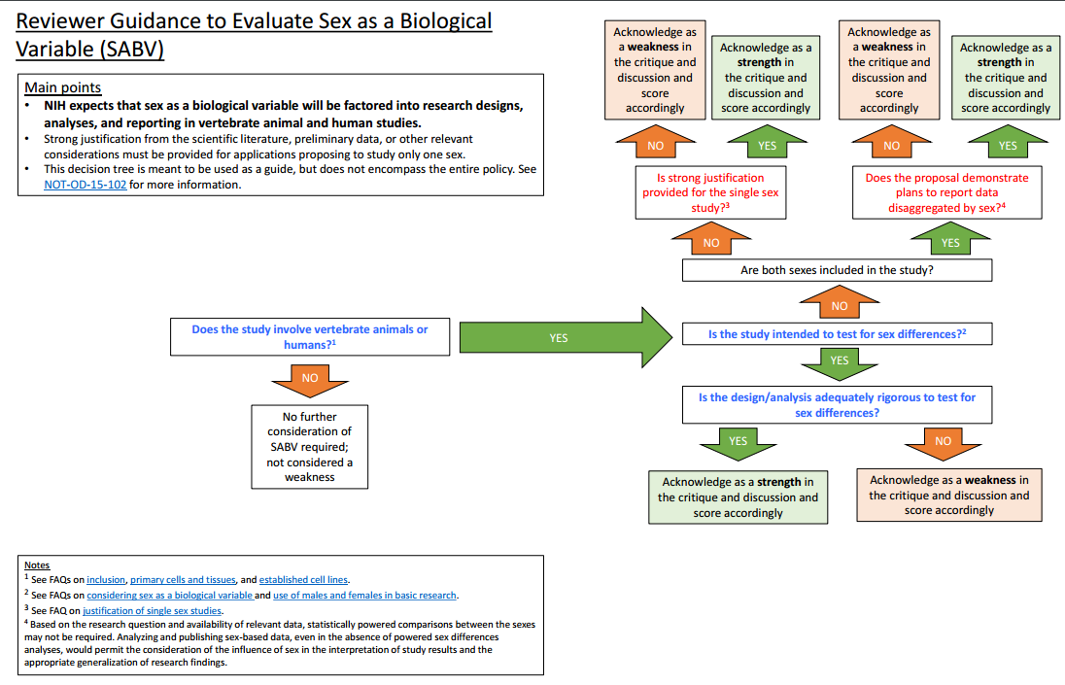

Slide 63
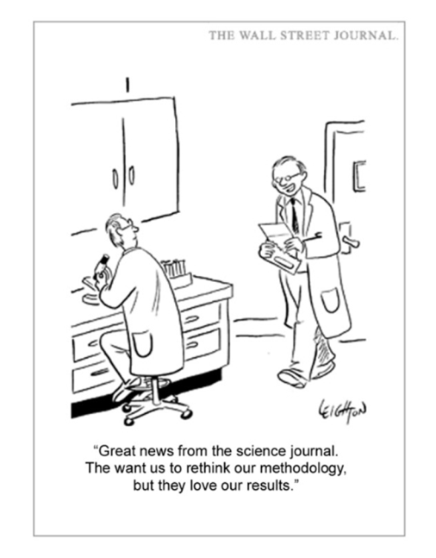
Thank You! Questions? reproducibility@nih.gov

