Slide 1
INTRODUCTION TO RESEARCH:
SAMPLING & Design
Part 3 of 3
By: Danielle Davidov, PhD
&
Steve Davis, MSW, MPA

Slide 2
Outline
Sampling
Research Designs
Prospective vs. Retrospective
Observational vs. Experimental

Slide 3
Steps in the research process
Remember the steps in the process of designing research?
  1) Identifying and Defining Variables
  2) Selecting Measurement Methods
  3) Selecting (Sample) Subjects*
  4) Selecting a Research Design*
  5) Establishing an Analysis Plan*
  *We covered steps 1 & 2 in Part 2, now we will focus on steps 3, 4, and 5 in the research design process

Slide 4
Selecting (Sampling) Subjects
Another step in the research design process involves describing your sample and choosing methods for selecting or recruiting subjects
When describing your population, it is important to establish specific inclusion and exclusion criteria
  The use of exclusion criteria is another method for controlling for CONFOUNDERS

Slide 5
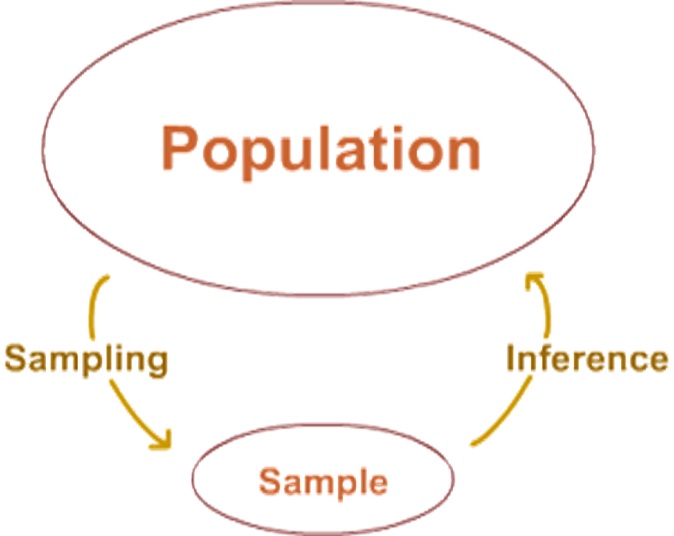
Selecting (Sampling) Subjects
The number one goal when choosing a method for selecting subjects is representativeness of the sample to the population of interest
If every person does not have an equal chance of being selected for participation in the study, then the study is BIASED

Slide 6
Random samples
Random Samples
  The random sample is used to control for the possibility of a BIASED sample.
  In a random sample every subject in the entire population has an equal chance of being selected
  A random sample also allows inferences to be made regarding the outcomes in the overall population

Slide 7
Selecting (Sampling) Subjects
In Emergency Medicine (and some other specialties) research we often have to settle for a convenience sample, which uses subjects that are immediately available
  AKA “whoever we can get”
Tip. Take a sample from different times of the year to control for seasonal variations in disease presentation, etc.

Slide 8
RAndomization
Randomization
  In many studies, a consecutive, convenience sample of subjects are randomized to receive either drug A or placebo (or intervention A versus intervention B, etc.)
  Randomization controls for the threat of CONFOUNDERS, even though it does not completely control BIAS
  In reality, when several randomized studies have been completed in multiple different settings, representativeness is assumed (leap of faith)

Slide 9
Sample size
Importance of Sample Size
  With a very small sample, you might not have enough people to find a statistically significant relationship, when in reality, one DOES exist
    This is a “Type II Error”
    A larger sample size decreases the probability of a Type II Error!!!
      Conducting a power analysis before you collect data will help you determine how many participants you need to find a significant difference if one does exist
    However, with a sample that is VERY large (e.g., 10,000 participants), even very small differences can turn out to be statistically significant
      But are they clinically meaningful?

Slide 10

Selecting a Research Design
The final aspect of research design involves choosing an overall design strategy that details when measurements will be taken, if a control group will be used, etc.
You may choose to collect your own data from human subjects (prospective, primary data collection) or analyze data that has already been collected (retrospective, secondary data collection/analysis)

Slide 11
Prospective & retrospective studies
Prospective versus Retrospective
  Prospective data collection strategies collect data on subjects over a future period of time
  Retrospective data collection strategies analyze data that HAS ALREADY BEEN COLLECTED.
  In general, prospective is better because data that has been collected retrospectively may have less reliability and validity. Missing data is also a major problem.
Notes:
With prospective, you can choose what you want to collect instead of relying on what someone before you wanted to collect. However, retrospective data can be very informative

Slide 12
Prospective vs. Retrospective
Prospective
  Primary Data Collection
  Pros
  Can choose participants
  Can choose instruments
  Can choose variables to be measured
  More reliable & valid
  Less missing data
  Can follow-up with participants
  Cons
  Expensive
  Very time consuming
  Takes a great deal of effort
  Need IRB approval if research is with human subjects
Retrospective
  Secondary Data Collection
  Pros
  Usually cheaper
  Usually less time consuming
  Most of the “hard” work has already been done for you
  Sometimes do not need IRB approval
  Some datasets have millions of records
  Cons
  Cannot choose participants
  Cannot choose instruments
  Cannot choose variables to be measured
  Less valid
  Less reliable
  Missing data

Slide 13
Observational & Experimental studies
Observational versus Experimental
  The main difference between the two is that experimental studies assign subjects to receive either a condition or serve in a control group
  Experimental Studies – Researcher directly MANIPULATES something
    Ex) Researcher gives blood pressure medication OR placebo to participants in two groups
  Observational Studies – Researcher OBSERVES two different groups
    Ex) Researcher gives surveys to two groups of patients—those who are on blood pressure medication and those who are not
Notes:
Obs – no direct manipulation; just observing something in nature and recording or making observations about it….researcher is not responsible for those already on or off medication

Slide 14
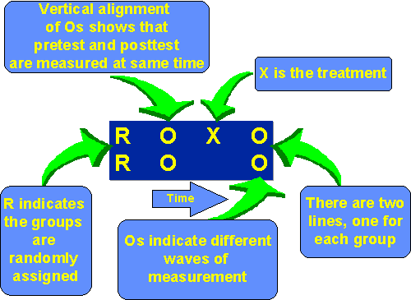
Research Design Notation
Research Design Notation
  O = Observation or Measurement
  X = Group, Intervention, or Treatment
  R = Randomization to Treatments

Slide 15
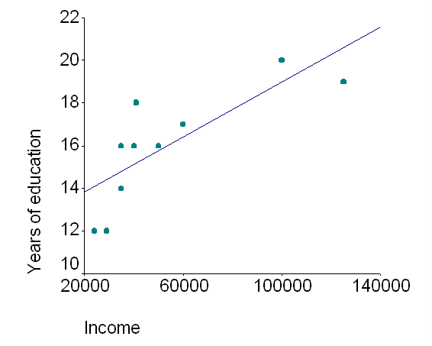
observational designs
Correlational Designs
  Notation: O
  Cross Sectional: All measurements taken at one point in time
    Capturing a “snapshot” of the phenomenon under study
  Popular, easy to conduct
  We cannot infer causality from this
  type of study
    Can only establish relationships
    Ex) As education increases, so does income
      But we can’t say that having more education
      RESULTS in higher income in our sample → this conclusion
      can only be made with a prospective design that follows the
      same participants over time!

Slide 16
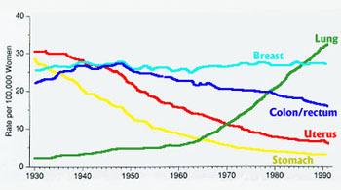
Observational designs
Longitudinal Designs
  O₁ O₂ O_{3……}O_{n}
  Cohort studies: Measurements are taken on a specific population of participants over a period of time
  Can establish trends (and relative risk/incidence of disease) between variables over time

Slide 17
observational designs
Pretest-Posttest
  O₁ X O₂
  “Before and after” educational designs
  Done to see if your intervention has had an effect
  More powerful because subjects serve as their own control
  Ex) Student takes test at beginning of semester, fails (O₁)
    Student attends class every week for 16 weeks (X)
    Student takes same test at end of class, receives 100% (O₂)
    We can conclude that attending class ( the intervention, “X”) led to an increase in the student’s knowledge of the material

Slide 18
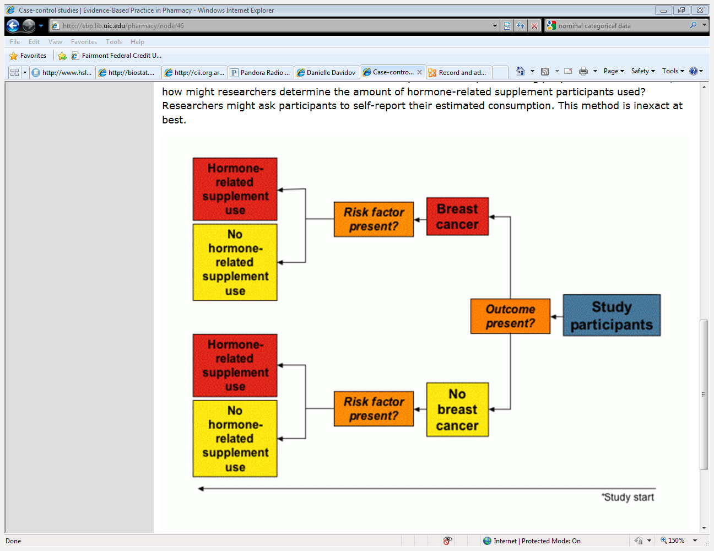
observational designs
Retrospective Case Control
  O₁
  O₂ Match
  Retrospective Chart Reviews (e.g., Merlin records)
Notes:
Match to see if your outcome of interest is bigger in one group than others

Slide 19
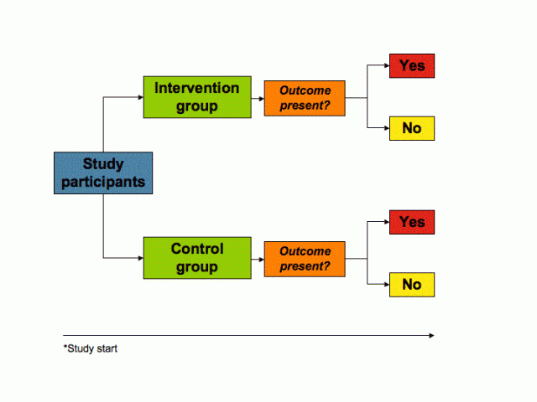
Experimental designs
The Randomized Controlled Trial (RCT)
  R X₁O₁
  R X₂O₂
  This is the “gold standard” of research designs

Slide 20
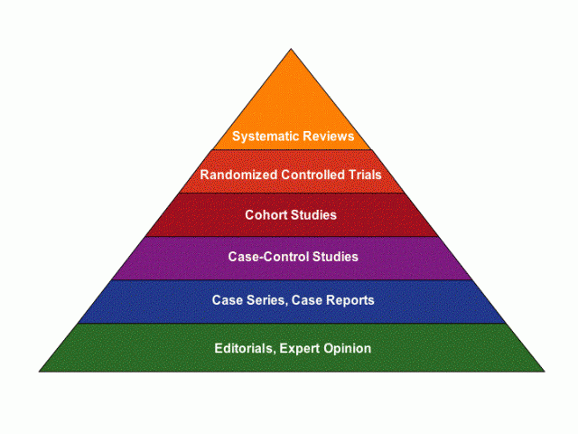

Research designs
More Evidence
Less Bias
Less Evidence
More Bias

Slide 21
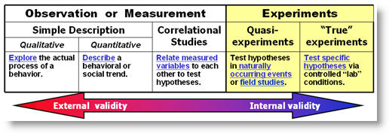
Research designs

Slide 22
The Analysis Plan
Once you have determined the levels of measurement of all variables AND have selected an overall research design you should consult a statistician regarding the choice of statistical tests and sample size calculations for power analysis if appropriate
We will talk more about data analysis and statistics in another presentation

Slide 23
Synthesis
The goal of research design is to minimize the three main threats to study conclusions (Chance, Bias, Confounding) during each stage of the design (variables, measurement methods, samples/subjects, overall design strategy, analysis plan).

Slide 24
References
Hulley SB, Cummings SR, Browner WS, Grady D, Hearst N, Newman TB. Designing Clinical Research. 2nd ed. Philadelphia, PA: Lippincott Williams & Wilkins; 2001:37-49
Spector PE. Research Designs. Newbury Park, CA: SAGE Publications, Inc.; 1981. ISBN: 0-8039-1709-0
http://www.research-assessment-adviser.com/levels-of-measurement.html
http://www.hsc.unt.edu/departments/cld/images/Bullseye60.jpg
http://www.socialresearchmethods.net/kb/desintro.php
http://www.thedoctorwillseeyounow.com/images/articles/asthma/drwomen.jpg
http://ebp.lib.uic.edu/pharmacy/node/46
http://t3.gstatic.com/images?q=tbn:ANd9GcRL-AunLoN_YTmg8Q3Mg7or8fjbFBKY3dJuhpWA5MmK3N7A4H9Tgw
http://www.uic.edu/classes/psych/psych242/images/ResearchStrategies.jpg

