Slide 1
Basic Statistics Overview
Danielle Davidov, PhD

Slide 2
Preface
The purpose of this presentation is to help you determine which statistical tests are appropriate for analyzing your data for your resident research project. It does not represent a comprehensive overview of all statistical tests and methods.
Your data may need to be analyzed using different statistical tests than are presented here, but this presentation focuses on the most common techniques.

Slide 3
Outline
Descriptive Statistics
  Frequencies & percentages
  Means & standard deviations
Inferential Statistics
  Correlation
  T-tests
  Chi-square
  Logistic Regression

Slide 4
Types of Statistics/Analyses
Descriptive Statistics
Describing a phenomena
  Frequencies
  Basic measurements
Inferential Statistics
  Hypothesis Testing
  Correlation
  Confidence Intervals
  Significance Testing
  Prediction
How many? How much?
BP, HR, BMI, IQ, etc.
Inferences about a phenomena
Proving or disproving theories
Associations between phenomena
If sample relates to the larger population
E.g., Diet and health

Slide 5

Descriptive Statistics
Descriptive statistics can be used to summarize and describe a single variable (aka, UNIvariate)
Frequencies (counts) & Percentages
  Use with categorical (nominal) data
    Levels, types, groupings, yes/no, Drug A vs. Drug B
Means & Standard Deviations
  Use with continuous (interval/ratio) data
    Height, weight, cholesterol, scores on a test

Slide 6
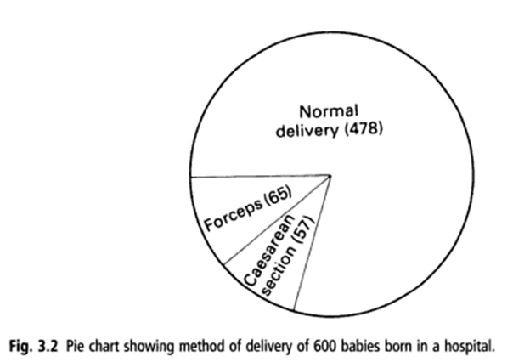
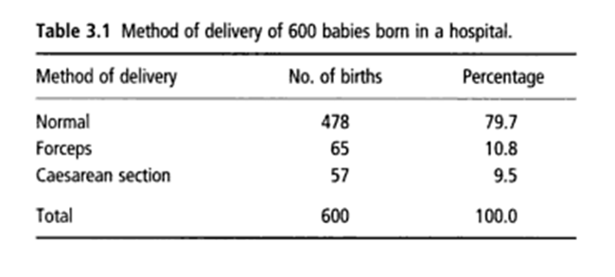
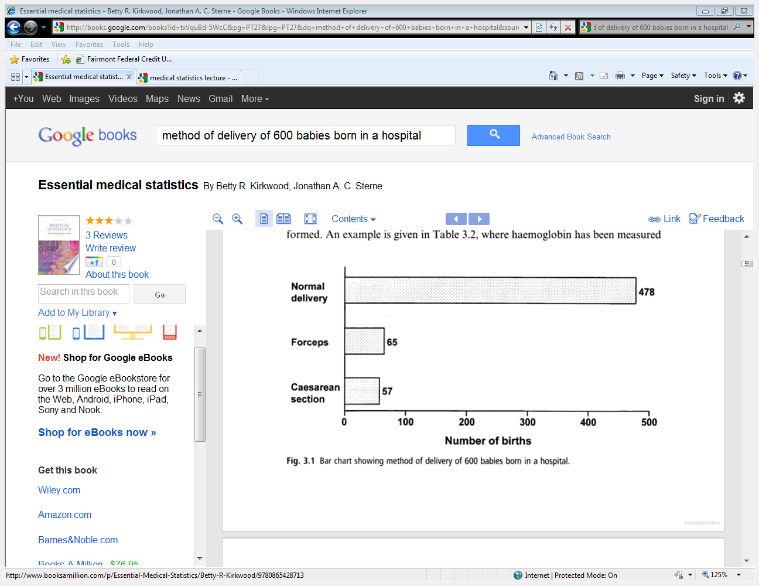
Frequencies & Percentages
Look at the different ways we can display frequencies and percentages for this data:
Pie chart
Table
AKA frequency distributions – good if more than 20 observations
Good if more than 20 observations
Bar chart

Slide 7
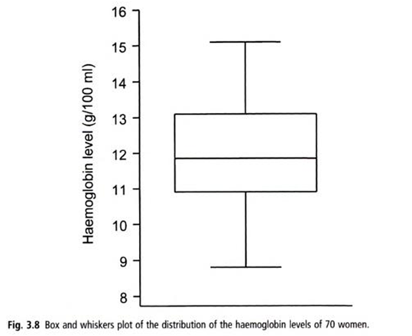
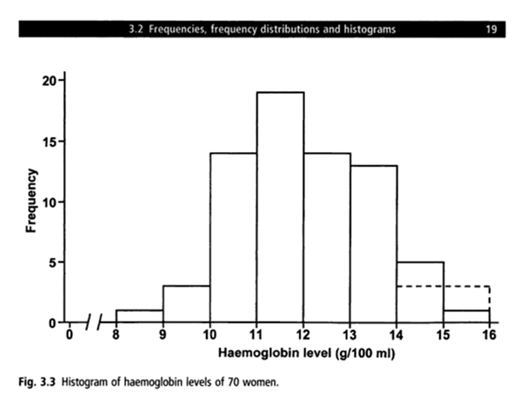
Distributions
The distribution of scores or values can also be displayed using Box and Whiskers Plots and Histograms

Slide 8
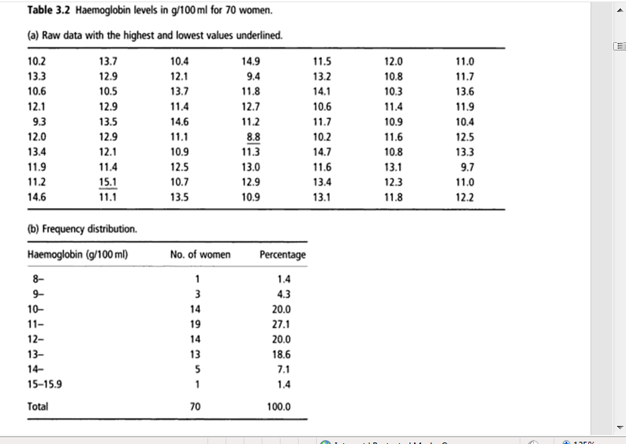
Continuous → Categorical
It is possible to take continuous data (such as hemoglobin levels) and turn it into categorical data by grouping values together. Then we can calculate frequencies and percentages for each group.

Slide 9
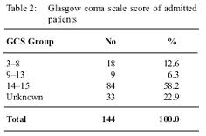
Continuous → Categorical
Distribution of Glasgow Coma Scale Scores
Even though this is continuous data, it is being treated as “nominal” as it is broken down into groups or categories
Tip: It is usually better to collect continuous data and then break it down into categories for data analysis as opposed to collecting data that fits into preconceived categories.

Slide 10
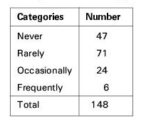
Ordinal Level Data
Frequencies and percentages can be computed for ordinal data
  Examples: Likert Scales (Strongly Disagree to Strongly Agree); High School/Some College/College Graduate/Graduate School

Slide 11
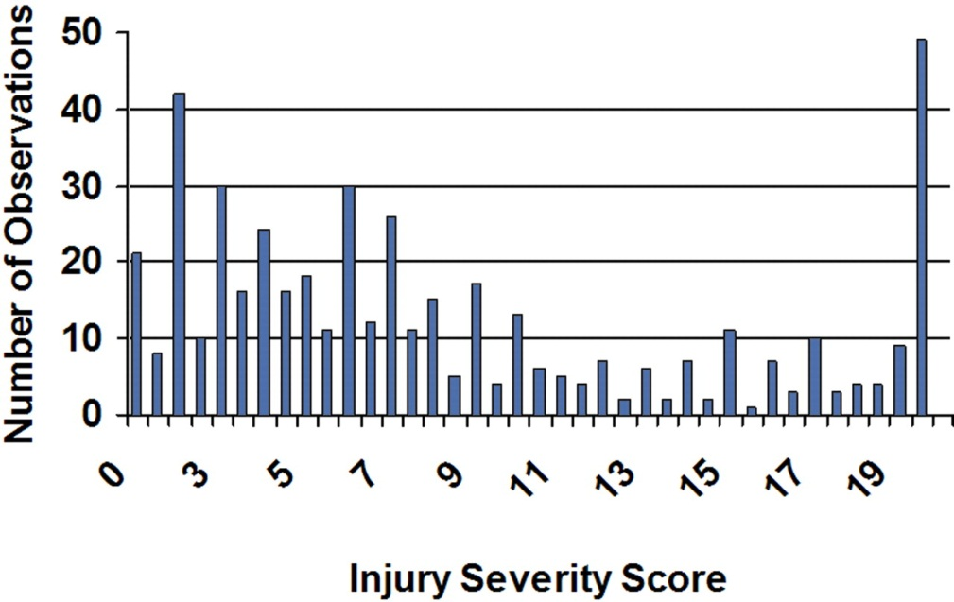
Interval/Ratio Data
We can compute frequencies and percentages for interval and ratio level data as well
  Examples: Age, Temperature, Height, Weight, Many Clinical Serum Levels
Distribution of Injury Severity Score in a population of patients

Slide 12
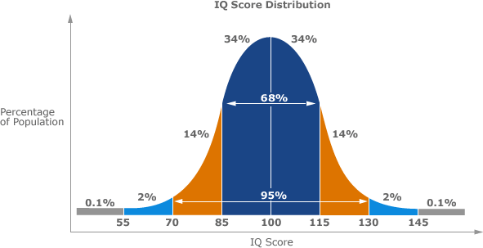
Interval/Ratio Distributions
The distribution of interval/ratio data often forms a “bell shaped” curve.
  Many phenomena in life are normally distributed (age, height, weight, IQ).

Slide 13
Interval & Ratio Data
Measures of central tendency and measures of dispersion are often computed with interval/ratio data
Measures of Central Tendency (aka, the “Middle Point”)
  Mean, Median, Mode
  If your frequency distribution shows outliers, you might want to use the median instead of the mean
      Measures of Dispersion (aka, How “spread out” the data are)
        Variance, standard deviation, standard error of the mean
        Describe how “spread out” a distribution of scores is
        High numbers for variance and standard deviation may mean that scores are “all over the place” and do not necessarily fall close to the mean
      In research, means are usually presented along with standard deviations or standard errors.

Slide 14
INFERENTIAL STATISTICS
Inferential statistics can be used to prove or disprove theories, determine associations between variables, and determine if findings are significant and whether or not we can generalize from our sample to the entire population
The types of inferential statistics we will go over:
Correlation
T-tests/ANOVA
Chi-square
Logistic Regression

Slide 15
Type of Data & Analysis
Analysis of Categorical/Nominal Data
  Correlation T-tests
  T-tests
Analysis of Continuous Data
  Chi-square
  Logistic Regression

Slide 16
Correlation
When to use it?
  When you want to know about the association or relationship between two continuous variables
    Ex) food intake and weight; drug dosage and blood pressure; air temperature and metabolic rate, etc.
What does it tell you?
  If a linear relationship exists between two variables, and how strong that relationship is
What do the results look like?
  The correlation coefficient = Pearson’s r
  Ranges from -1 to +1
  See next slide for examples of correlation results

Slide 17
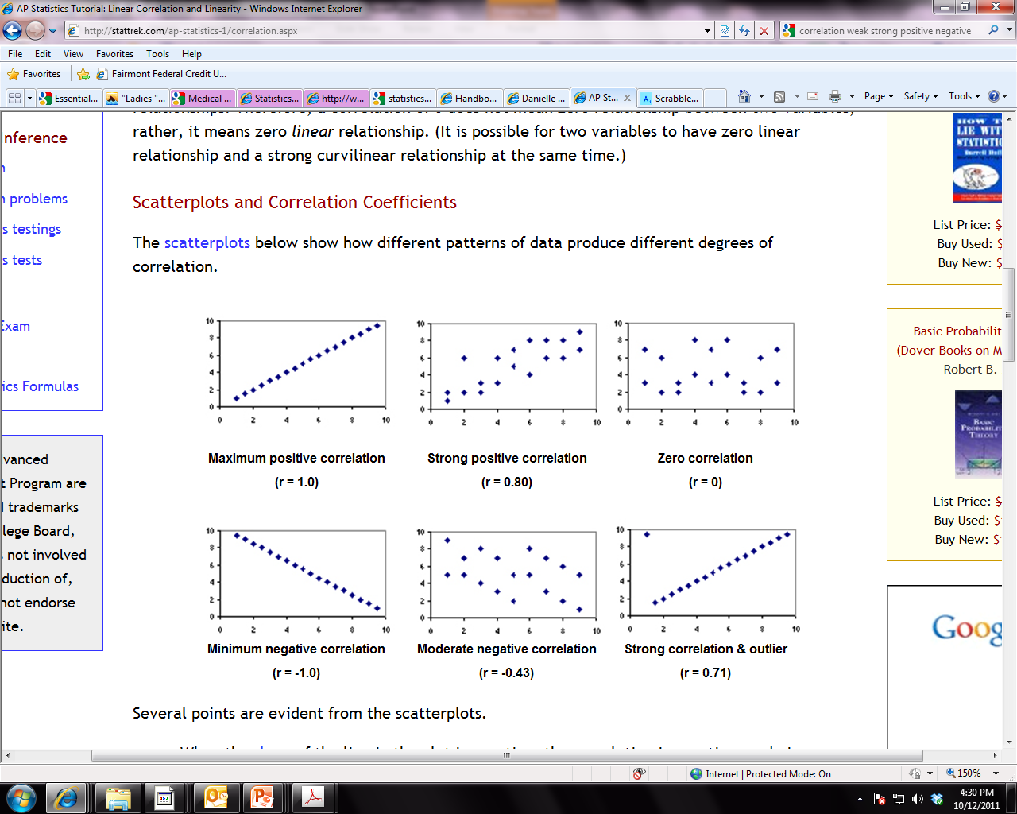
Correlation
Guide for interpreting strength of correlations:
  0 – 0.25 = Little or no relationship
  0.25 – 0.50 = Fair degree of relationship
  0.50 - 0.75 = Moderate degree of relationship
  0.75 – 1.0 = Strong relationship
  1.0 = perfect correlation

Slide 18
Correlation
How do you interpret it?
  If r is positive, high values of one variable are associated with high values of the other variable (both go in SAME direction - ↑↑ OR ↓↓)
    Ex) Diastolic blood pressure tends to rise with age, thus the two variables are positively correlated
  If r is negative, low values of one variable are associated with high values of the other variable (opposite direction - ↑↓ OR ↓ ↑)
    Ex) Heart rate tends to be lower in persons who exercise frequently, the two variables correlate negatively
  Correlation of 0 indicates NO linear relationship
How do you report it?
  “Diastolic blood pressure was positively correlated with age (r = .75, p < . 05).”
  Tip: Correlation does NOT equal causation!!! Just because two variables are highly correlated, this does NOT mean that one CAUSES the other!!!

Slide 19
T-tests
When to use them?
  Paired t-tests: When comparing the MEANS of a continuous variable in two non-independent samples (i.e., measurements on the same people before and after a treatment)
    Ex) Is diet X effective in lowering serum cholesterol levels in a sample of 12 people?
    Ex) Do patients who receive drug X have lower blood pressure after treatment then they did before treatment?
  Independent samples t-tests: To compare the MEANS of a continuous variable in TWO independent samples (i.e., two different groups of people)
    Ex) Do people with diabetes have the same Systolic Blood Pressure as people without diabetes?
    Ex) Do patients who receive a new drug treatment have lower blood pressure than those who receive a placebo?
    Tip: if you have > 2 different groups, you use ANOVA, which compares the means of 3 or more groups

Slide 20
T-tests
What does a t-test tell you?
  If there is a statistically significant difference between the mean score (or value) of two groups (either the same group of people before and after or two different groups of people)
What do the results look like?
  Student’s t
How do you interpret it?
  By looking at corresponding p-value
    If p < .05, means are significantly different from each other
    If p > 0.05, means are not significantly different from each other

Slide 21
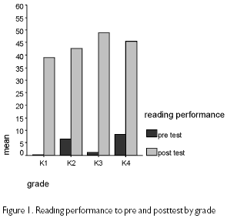
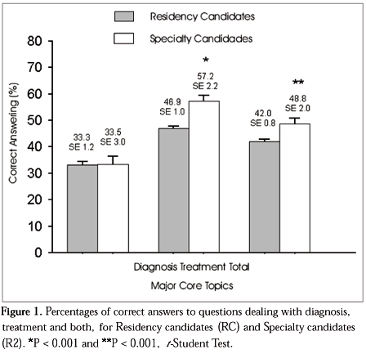
How do you report t-tests results?
“As can be seen in Figure 1, children’s mean reading performance was significantly higher on the post-tests in all four grades, ( t = [insert from stats output], p < .05)”
“As can be seen in Figure 1, specialty candidates had significantly higher scores on questions dealing with treatment than residency candidates (t = [insert t-value from stats output], p < .001).

Slide 22
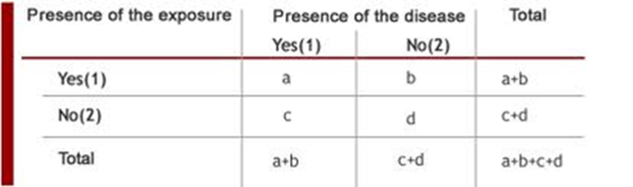
Chi-square
When to use it?
  When you want to know if there is an association between two categorical (nominal) variables (i.e., between an exposure and outcome)
    Ex) Smoking (yes/no) and lung cancer (yes/no)
    Ex) Obesity (yes/no) and diabetes (yes/no)
What does a chi-square test tell you?
  If the observed frequencies of occurrence in each group are significantly different from expected frequencies (i.e., a difference of proportions)

Slide 23
Chi-square
What do the results look like?
  Chi-square test statistics = X²
How do you interpret it?
  Usually, the higher the chi-square statistic, the greater likelihood the finding is significant, but you must look at the corresponding p-value to determine significance
Tip: Chi square requires that there be 5 or more in each cell of a 2x2 table and 5 or more in 80% of cells in larger tables. No cells can have a zero count.

Slide 24
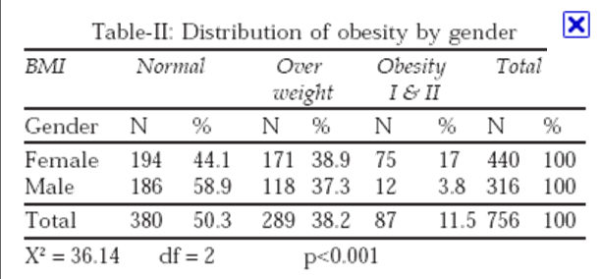

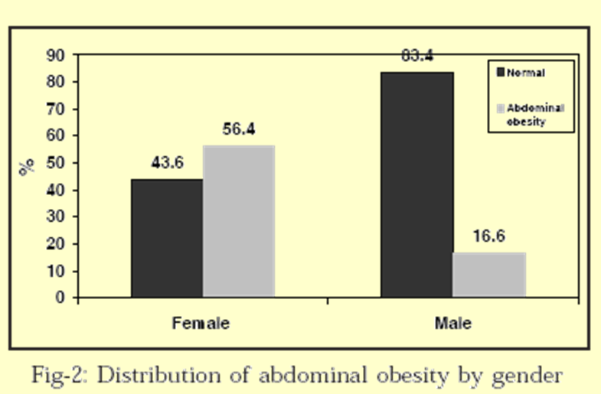
How do you report chi-square?
“248 (56.4%) of women and 52 (16.6%) of men had abdominal obesity (Fig-2). The Chi square test shows that these differences are statistically significant (p<0.001).”
“Distribution of obesity by gender showed that 171 (38.9%) and 75 (17%) of women were overweight and obese (Type I &II), respectively. Whilst 118 (37.3%) and 12 (3.8%) of men were overweight and obese (Type I & II), respectively (Table-II).
The Chi square test shows that these differences are statistically significant (p<0.001).”

Slide 25
Logistic Regression
When to use it?
  When you want to measure the strength and direction of the association between two variables, where the dependent or outcome variable is categorical (e.g., yes/no)
  When you want to predict the likelihood of an outcome while controlling for confounders
    Ex) examine the relationship between health behavior (smoking, exercise, low-fat diet) and arthritis (arthritis vs. no arthritis)
    Ex) Predict the probability of stroke in relation to gender while controlling for age or hypertension
What does it tell you?
  The odds of an event occurring→ The probability of the outcome event occurring divided by the probability of it not occurring

Slide 26
Logistic Regression
What do the results look like?
    Odds Ratios (OR) & 95% Confidence Intervals (CI)
How do you interpret the results?
  Significance can be inferred using by looking at confidence intervals:
    If the confidence interval does not cross 1 (e.g., 0.04 – 0.08 or 1.50 – 3.49), then the result is significant
  If OR > 1 → The outcome is that many times MORE likely to occur
    The independent variable may be a RISK FACTOR
    1.50 = 50% more likely to experience event or 50% more at risk
    2.0 = twice as likely
    1.33 = 33% more likely
  If OR < 1 → The outcome is that many times LESS likely to occur
    The independent variable may be a PROTECTIVE FACTOR
    0.50 = 50% less likely to experience the event
    0.75 = 25% less likely

Slide 27
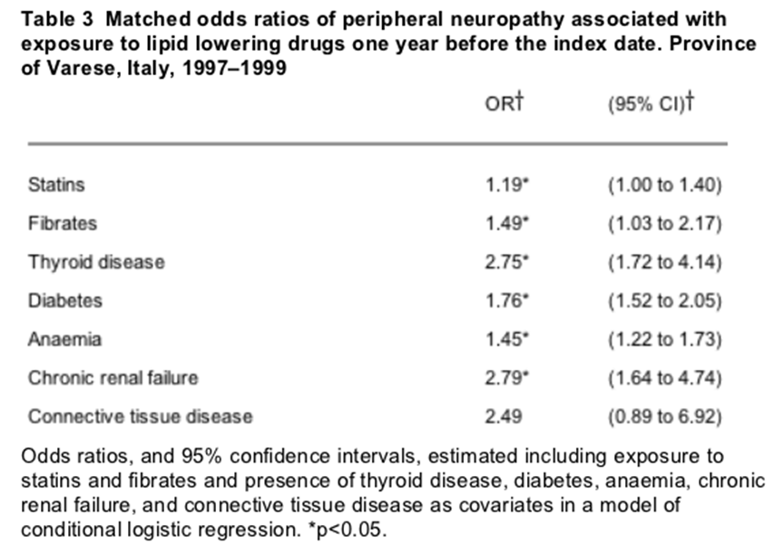
How do you report Logistic Regression?
Those taking lipid lowering drugs had greater risk for neuropathy
49% increased risk
control
variables
Confidence Interval crosses 1 → NOT SIGNIFICANT !!!
“Table 3 shows the effects of both statins and fibrates adjusted for the concomitant conditions on the risk of peripheral neuropathy. With the exception of connective tissue disease, significant increased risks were observed for all the other concomitant conditions. Odds ratios associated with both statins and fibrates were also significant.”

Slide 28
Summary of Statistical Tests
Statistic Test | Type of Data Needed | Test Statistic | Example
Correlation | Two continuous variables | Pearson’s r | Are blood pressure and weight correlated?
T-tests/ANOVA | Means from a continuous variable taken from two or more groups | Student’s t | Do normal weight (group 1) patients have lower blood pressure than obese patients (group 2)?
Chi-square | Two categorical variables | Chi-square X² | Are obese individuals (obese vs. not obese) significantly more likely to have a stroke (stroke vs. no stroke)?
Logistic Regression | A dichotomous variable as the outcome | Odds Ratios (OR) & 95% Confidence Intervals (CI) | Does obesity predict stroke (stroke vs. no stroke) when controlling for other variables?

Slide 29
Summary
Descriptive statistics can be used with nominal, ordinal, interval and ratio data
Frequencies and percentages describe categorical data and means and standard deviations describe continuous variables
Inferential statistics can be used to determine associations between variables and predict the likelihood of outcomes or events
Inferential statistics tell us if our findings are significant and if we can infer from our sample to the larger population

Slide 30
Next Steps
Think about the data that you have collected or will collect as part of your research project
  What is your research question?
  What are you trying to get your data to “say”?
  Which statistical tests will best help you answer your research question?
  Contact the research coordinator to discuss how to analyze your data!

Slide 31
References
Essential Medical Statistics. Kirkwood & Sterne, 2nd Edition. 2003
http://ocw.tufts.edu/Content/1/lecturenotes/193325
http://stattrek.com/AP-Statistics-1/Association.aspx?Tutorial=AP
http://udel.edu/~mcdonald/statcentral.html
Background to Statistics for Non-Statisticians. Powerpoint Lecture. Dr. Craig Jackson , Prof. Occupational Health Psychology , Faculty of Education, Law & Social Sciences, BCU. ww.hcc.uce.ac.uk/craigjackson/Basic%20Statistics.ppt.

